Slide 1
Simulations – rates distributions Filip Krasniqi, Jocelyne Elias and Jérémie Leguay
July 03, 2019

Slide 2
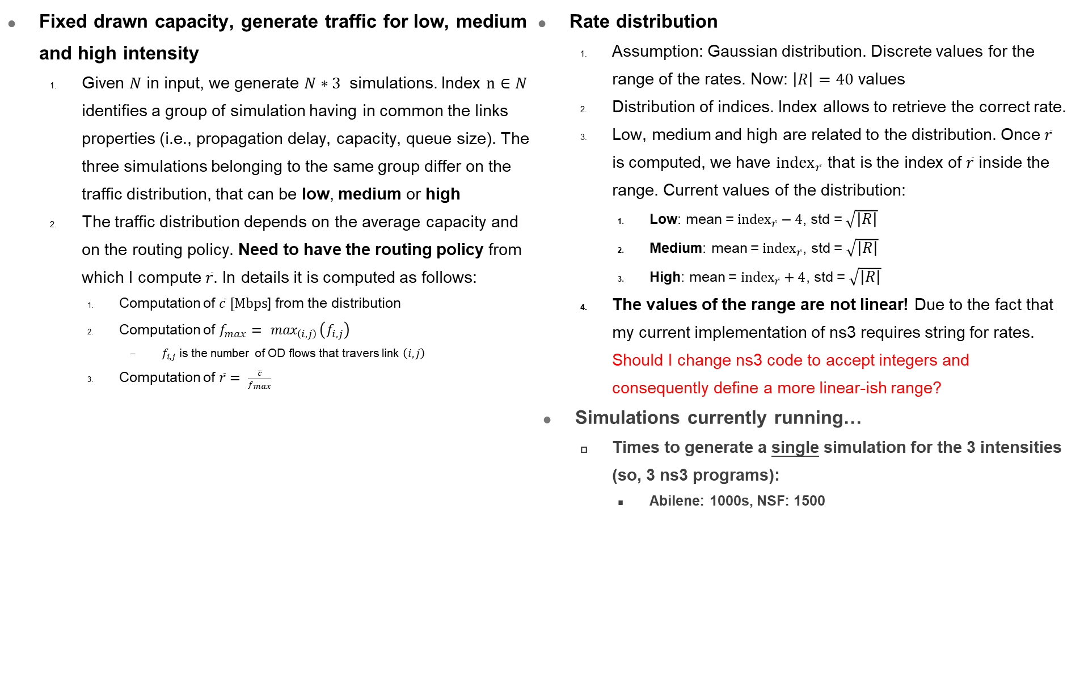
Updates
Fixed drawn capacity, generate traffic for low, medium and high intensity
Given $N$ in input, we generate $N∗3$ simulations. Index $n∈N$ identifies a group of simulation having in common the links properties (i.e., propagation delay, capacity, queue size). The three simulations belonging to the same group differ on the traffic distribution, that can be low, medium or high
The traffic distribution depends on the average capacity and on the routing policy. Need to have the routing policy from which I compute $\overline{r}$. In details it is computed as follows:
Computation of $\overline{c} [Mbps$] from the distribution
Computation of $f_{max}=\max_{\left(i,j\right)}\left(f_{i,j}\right)$
$f_{i,j}$ is the number of OD flows that travers link $\left(i,j\right)$
Computation of $\overline{r}= \frac{\overline{c}}{f_{max}}$
Rate distribution
Assumption: Gaussian distribution. Discrete values for the range of the rates. Now: $\left|R\right|=40$ values
Distribution of indices. Index allows to retrieve the correct rate.
Low, medium and high are related to the distribution. Once $\overline{r}$ is computed, we have ${index}_{\overline{r}}$ that is the index of $\overline{r}$ inside the range. Current values of the distribution:
Low: mean = ${index}_{\overline{r}}−4$, std = $\sqrt{\left|R\right|}$
Medium: mean = ${index}_{\overline{r}}$, std = $\sqrt{\left|R\right|}$
High: mean = ${index}_{\overline{r}}+4$, std = $\sqrt{\left|R\right|}$
The values of the range are not linear! Due to the fact that my current implementation of ns3 requires string for rates. Should I change ns3 code to accept integers and consequently define a more linear-ish range?
Simulations currently running…
Times to generate a single simulation for the 3 intensities (so, 3 ns3 programs):
Abilene: 1000s, NSF: 1500

Slide 3
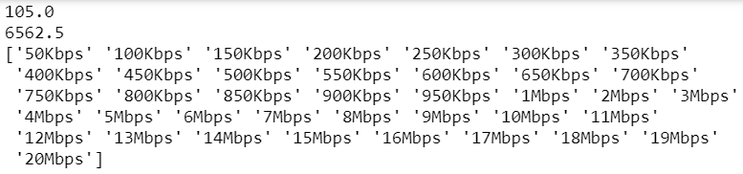
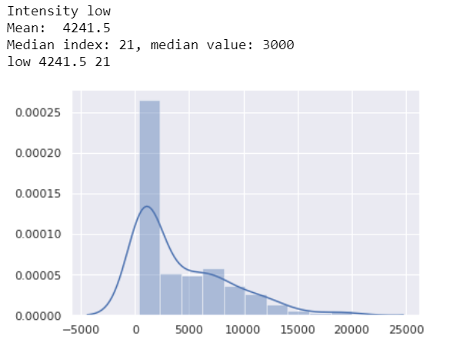
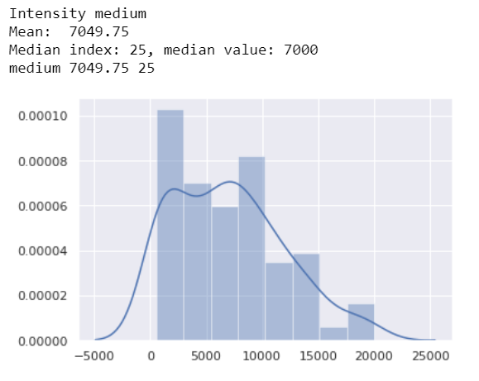
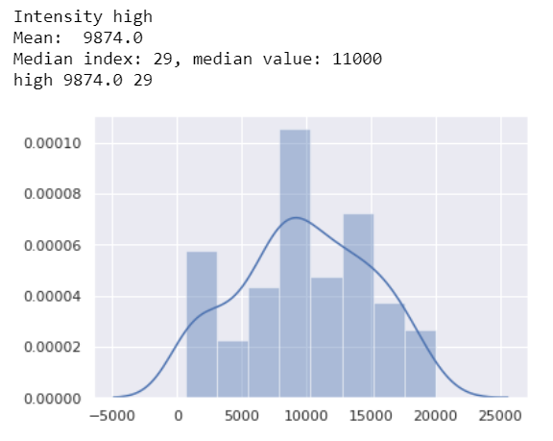
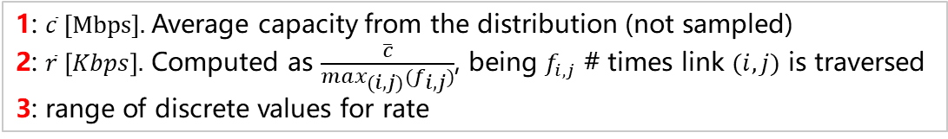
Rates: Abilene
1
2
1: $\overline{c} [Mbps].$Average capacity from the distribution (not sampled)
2: $\overline{r} \left[Kbps\right].$ Computed as $\frac{\overline{c}}{\max_{(i,j)}(f_{i,j})}$, being $f_{i,j}$ # times link $(i,j)$ is traversed
3: range of discrete values for rate
3
4
5
4: mean and median for distribution
5: distribution of rates provided in case of low, medium and high intensity
Pay attention to the fact that rates are not linear. The current range considers 20 values for Kbps (linear from 50 to 950),
and 20 for Mbps (linear from 1 to 20).

Slide 4
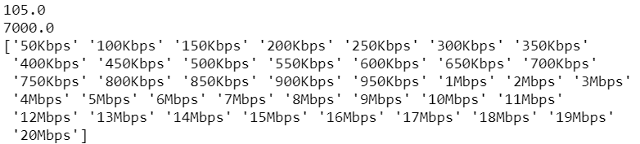
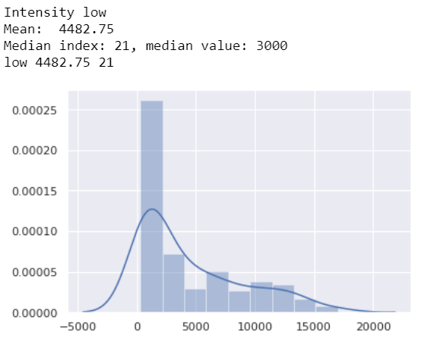
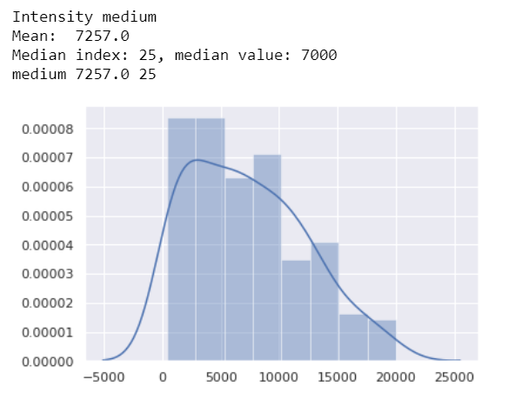
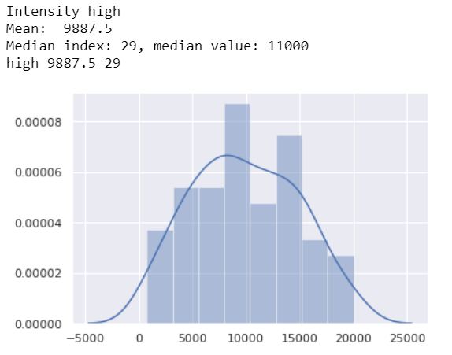

Rates: nsf
1
2
1: $\overline{c} [Mbps].$Average capacity from the distribution (not sampled)
2: $\overline{r} \left[Kbps\right].$ Computed as $\frac{\overline{c}}{\max_{(i,j)}(f_{i,j})}$, being $f_{i,j}$ # times link $(i,j)$ is traversed
3: range of discrete values for rate
3
4
5
4: mean and median for distribution
5: distribution of rates provided in case of low, medium and high intensity
Pay attention to the fact that rates are not linear. The current range considers 20 values for Kbps (linear from 50 to 950),
and 20 for Mbps (linear from 1 to 20).

Slide 5
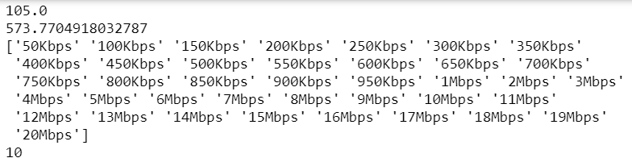
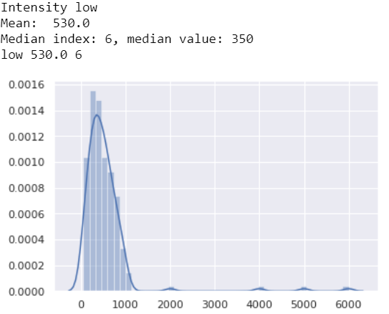
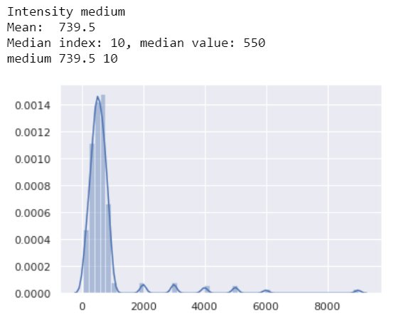
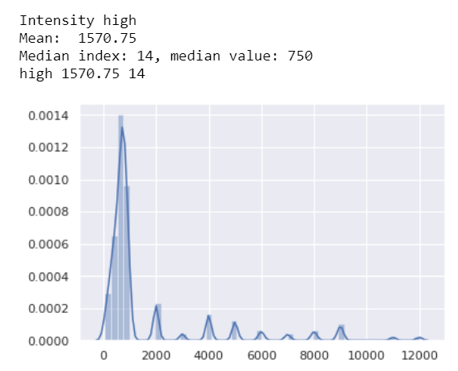
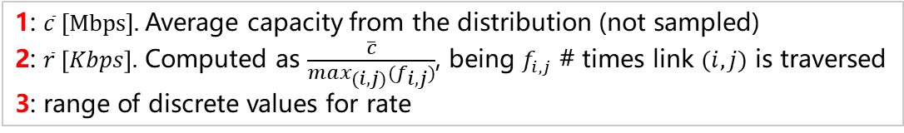
Rates: Geant2
1
2
1: $\overline{c} [Mbps].$Average capacity from the distribution (not sampled)
2: $\overline{r} \left[Kbps\right].$ Computed as $\frac{\overline{c}}{\max_{(i,j)}(f_{i,j})}$, being $f_{i,j}$ # times link $(i,j)$ is traversed
3: range of discrete values for rate
3
4
5
4: mean and median for distribution
5: distribution of rates provided in case of low, medium and high intensity
Pay attention to the fact that rates are not linear. The current range considers 20 values for Kbps (linear from 50 to 950),
and 20 for Mbps (linear from 1 to 20).

Slide 6
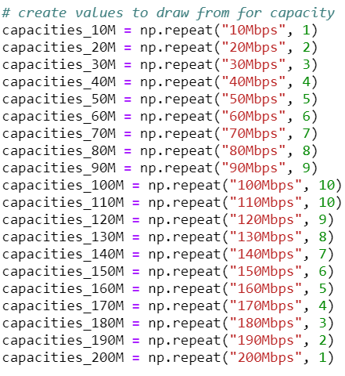
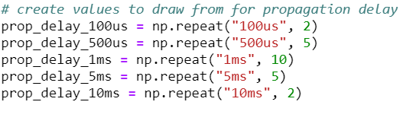
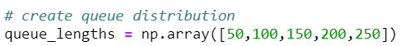
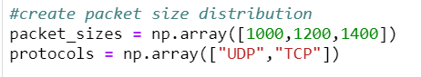
More details on the other values
Link
Any suggestions on these values?
And about the rates range?
Traffic

